Slide 1
Python by smell
Advanced Python constructs for scientists
Jana Sperschneider
Pietro Berkes, Nagra Insight

Slide 2
What’s this smell?
You’re here because you started feeling the “code smell”
Scientists in the wild tend to write this…
What is the smell of the code in the notebooks?
Notes:
“code smell” is an actual technical term!
~/n/MH/nagra_git/thesis/generative Open Generative%20model%20-%20Mixture%20of%20gaussians_EM_markovModels_soft_clustering-plotLH-C%2BCLEAN-LH_TEST-4k-Copy1.ipynb
Then open any other with similar name
It smells like you need a Python module

Slide 3
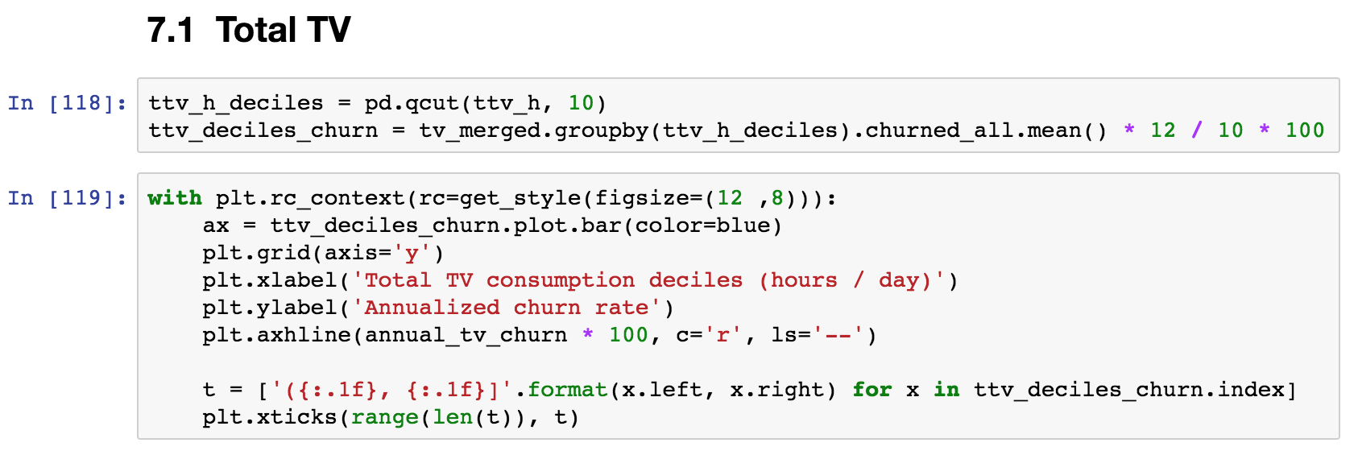
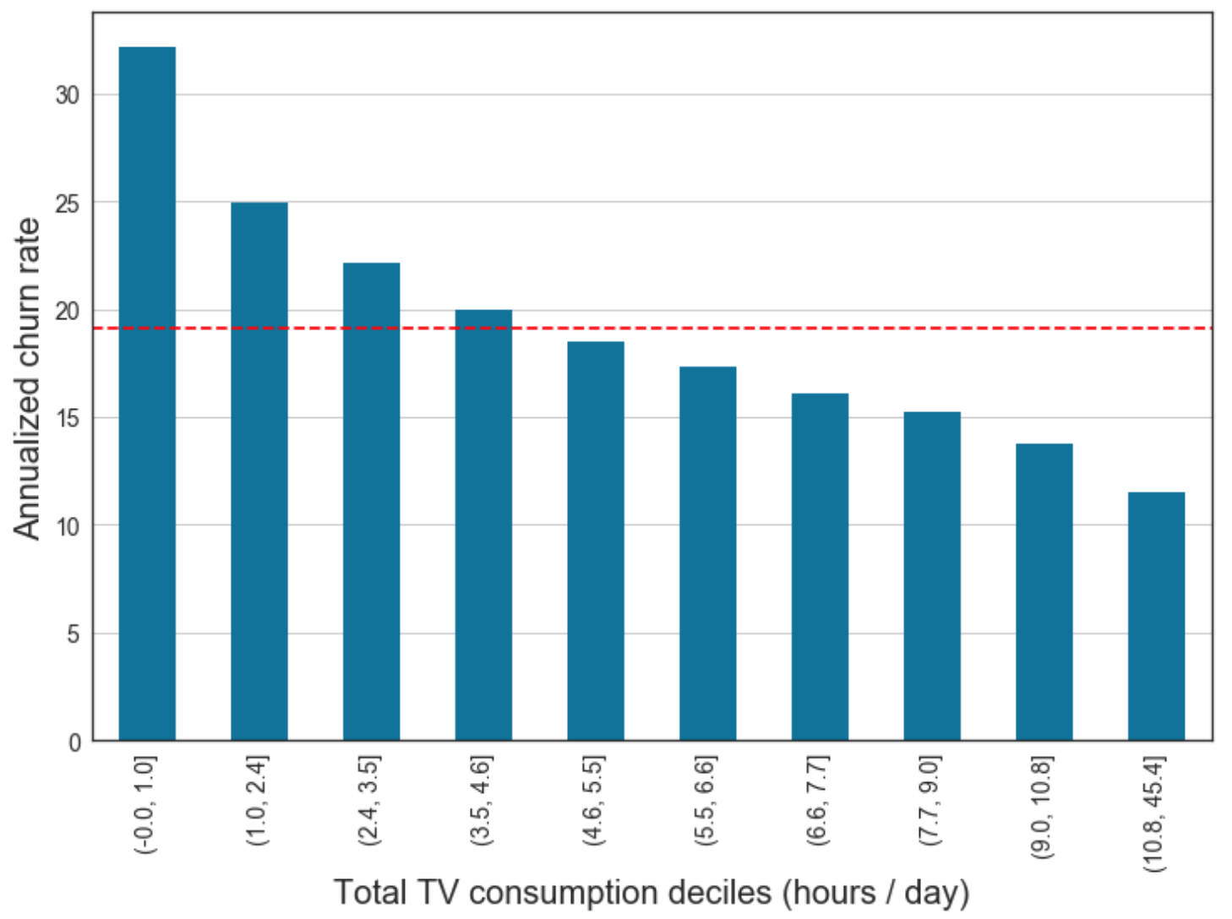
What about this smell?

Slide 4
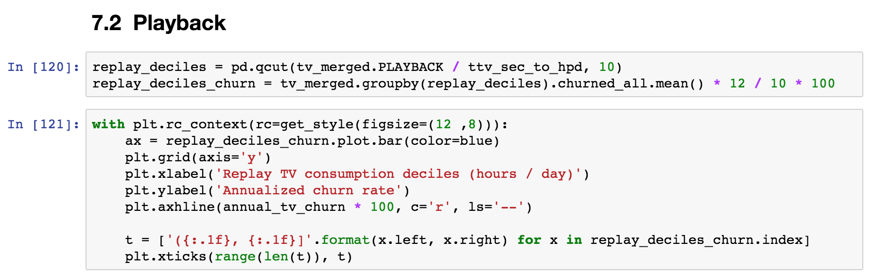
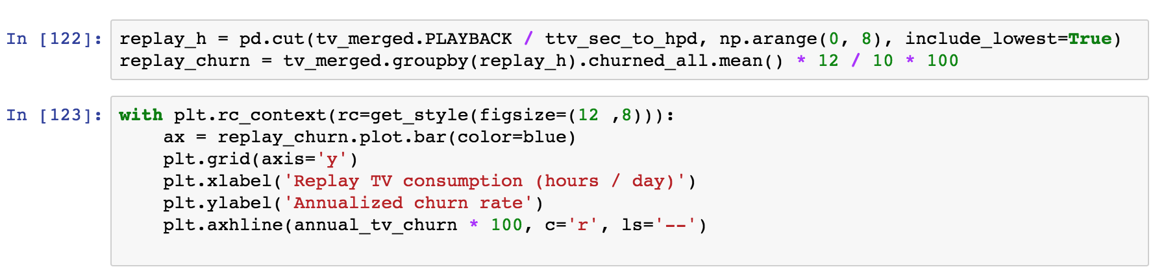
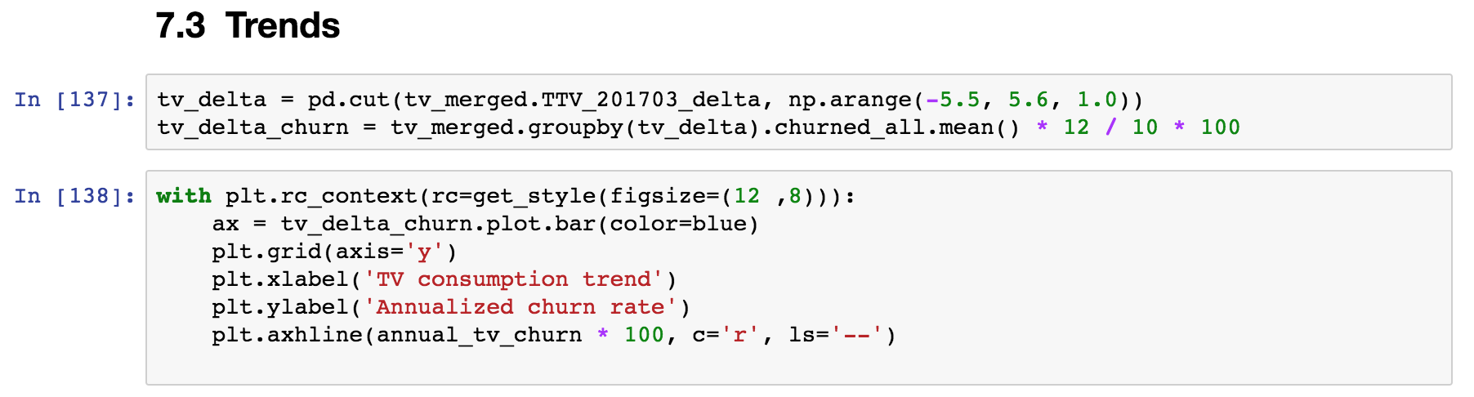
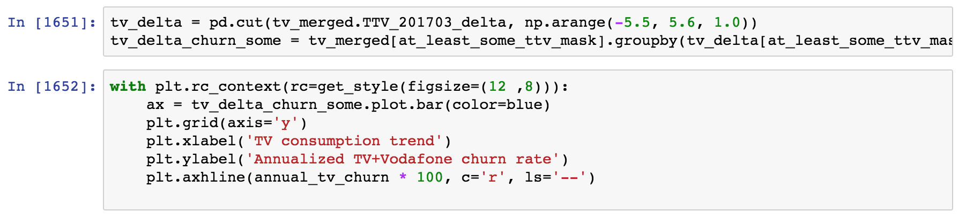
What about this smell?

Slide 5
What is wrong with smelly code?
Redundant, not flexible: an update in one place would need to be duplicated everywhere
Hard to test: the code that performs the interesting computation is mixed with the code that does the repetitive boilerplate

Slide 6
Objective
This is a code smell detection crash course for scientific programming
Advanced Python constructs are the way to get rid of the smell!
Notes:
These constructs are not very common in scientific code, and you don’t actually ”need” them. But the same is true of functions!

Slide 7
All the “advanced Python constructs” smells
The smell of generators
The smell of context managers
for ... :
# Transform / filter
for ... :
# Transform / filter
# The interesting part of the code
# Prepare
try:
# The code you care about
finally:
# Clean up
The smell of classes
The smell of decorators
def first_function(x, y, z):
# Something
def second_function(x, y, z):
# Something else
def third_function(x, y, z):
# Something more
def my_function(x, y, z):
# Common boilerplate at beginning
# Function-specific part
# Common boilerplate at end
Of all of the most commonly used Python constructs, context managers are neck-and-neck with decorators in a "Things I use but don't really understand how they work" contest.
https://jeffknupp.com/blog/2016/03/07/python-with-context-managers/

Slide 8
The smell of generators
One or more nested loops, variables over which one iterates requires some extra transformation or filtering
for ... :
# Transform / filter
for ... :
# Transform / filter
# The interesting part of the code
This is the part that actually does some interesting computation. At the moment, it’s hard to test it!
… becomes …
for ... in my_generator():
# The interesting part of the code

Slide 9
The smell of classes
def first_function(x, y, z):
# Something
def second_function(x, y, z):
# Something else
def third_function(x, y, z):
# Something more
The same set of parameters is needed for a set of functions. In code calling this function, one needs extra code to keep these parameters in sync.
… becomes …
def first_function(xyz):
# Something
def second_function(xyz):
# Something else
def third_function(xyz):
# Something more
class Xyz:
def __init__(self, x, y, z):
...

Slide 10
The smell of context managers
Before executing the code, something needs to happen: open a file, connect to a DB, initialize some hardware
# Initialize context
try:
# The code you care about
finally:
# Clean up context
Once the code has executed, we need to clean up, even if an error occurred: close the file, commit / revert SQL transactions, disconnect from hardware
… becomes …
with my_context_manager():
# The code you care about

Slide 11
The smell of decorators
Boilerplate code at the start and/or end of functions.
Typical cases: logging, deprecation, conditions checks, caching
def my_function(x, y, z):
# Boilerplate at start
# Function-specific part
# Boilerplate at end
This is the part that is specific to what the function actually does
… becomes …
@my_decorator
def my_function(x, y, z):
# Function-specific part
Decorators are are functions which modify the functionality of other functions.

Slide 12
One smell at the time: generators first

Slide 13
A simple example: when are generators cleaner?
# Print square numbers up to 100,000 that are odd and do something with them
for i in range(100000):
if (i*i) % 2:
do_something(i*i)
my_numbers = [i*i for i in range(100000) if (i*i) % 2]
my_numbers[:10]
[1, 9, 25, 49, 81, 121, 169, 225, 289, 361]
do_something(my_numbers)
Smelly!
Memory!

Slide 14
A simple example: when are generators cleaner?
# Print square numbers up to 100,000 that are odd and do something with them
for i in range(100000):
if (i*i) % 2:
do_something(i*i)
my_numbers = [i*i for i in range(100000) if (i*i) % 2]
my_numbers[:10]
[1, 9, 25, 49, 81, 121, 169, 225, 289, 361]
do_something(my_numbers)
Smelly!
Memory!
def square_numbers(n):
i = 1
while i <= n:
if (i*i) % 2:
yield i*i
i += 1
for squared in square_numbers(100000):
do_something(squared)
Yield instead of return!

Slide 15
The smell of generators
One or more nested loops, variables over which one iterates requires some extra transformation or filtering
for ... :
# Transform / filter
for ... :
# Transform / filter
# The interesting part of the code
This is the part that actually does some interesting computation. At the moment, it’s hard to test it!
… becomes …
for ... in my_generator():
# The interesting part of the code

Slide 16
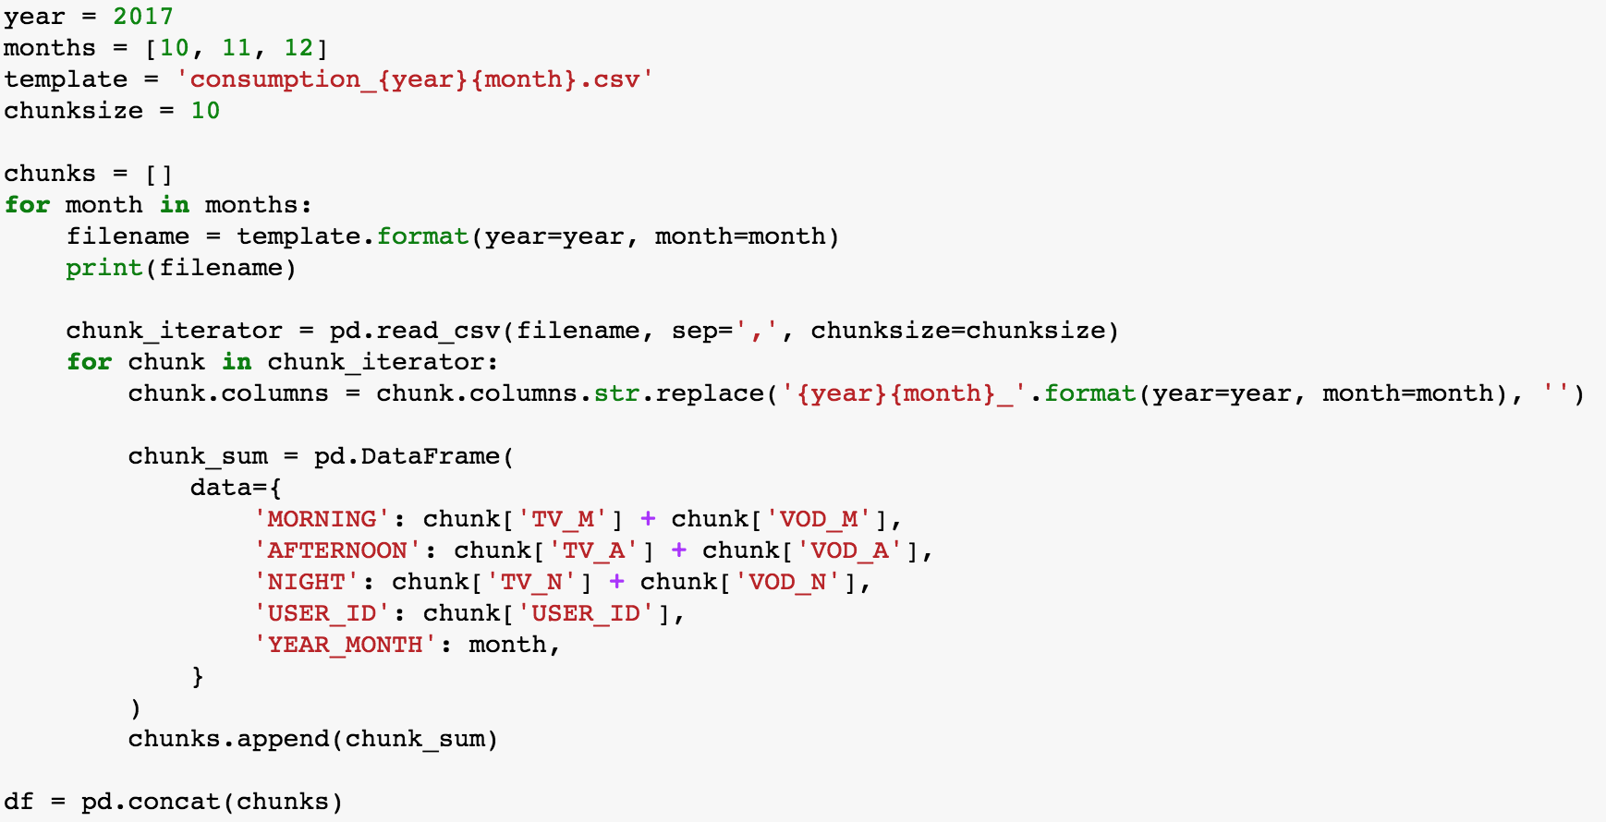
Example
Iterate
Clean
Aggregate
Concat
Notes:
Explain context…
Needed to do this for different years, with different computations
Testing this thing will require creating fake, messy files <- this is a complicated point to make, with a generator it requires mocking it…

Slide 17
Ideally…
df = pf.concat(aggregate(clean(iterate(months, year, chunksize))))
This is actually what we’d like to write:
Extract each for-loop step in a reusable element and give it a nice name
Do all of this without actually loading all the data in memory for the intermediate steps!
Let’s get there step by step…

Slide 18
Go to “generators” notebooks

Slide 19
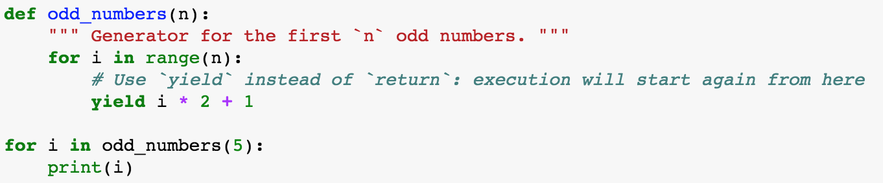
Recap: Generators
Generators are used to get rid of repetitive loops, often nested ”for” loops followed by filtering of the data
Generators return one item at the time, the list of items does not need to be in memory
A generator is defined as a function containing the keyword ”yield”:

Slide 20
One smell at the time: classes (an introduction)

Slide 21
The smell of classes
def first_function(x, y, z):
# Something
def second_function(x, y, z):
# Something else
def third_function(x, y, z):
# Something more
The same set of parameters is needed for a set of functions. In code calling this function, one needs extra code to keep these parameters in sync.
… becomes …
def first_function(xyz):
# Something
def second_function(xyz):
# Something else
def third_function(xyz):
# Something more
class Xyz:
def __init__(self, x, y, z):
...

Slide 22
Go to “classes” notebooks

Slide 23
Recap: Classes
Classes are used to get rid of set of parameters that belong together and are passed over and over to a set of functions
Classes are templates for bundles of data and “methods”, i.e. functions that have access to the data stored in an instance
A ”class method” is used to build an instance in some alternative way, e.g. using data from a file

Slide 24
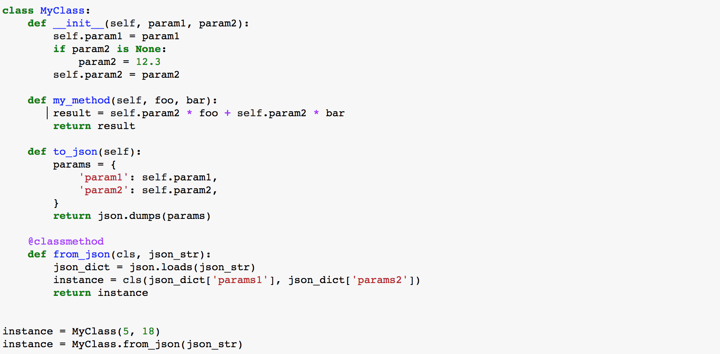
Recap: Class structure
The constructor is used to first populate an instance, called by convention “self”
Classes can define “methods”, i.e. functions that have access to the data stored in an instance
A ”class method” is used to build an instance in some alternative way, e.g. using data from a file
Here is how you create instances from the constructor or a class method

Slide 25
What belongs to a class?
YES
Data that always belongs together: better create several simple classes than one class that contains everything
Methods to load/save data, create data bundle in different ways (factory methods)
Methods to update parameters
NO
Methods to visualize data: follow the Model-View pattern. You will want to visualize the data in many different ways, better have separate utility visualization functions that take one of the instances as input and visualize them.
Similarly, anything for which you can imagine to write 5 different variants depending on your mood
Notes:
Data that belongs together, example of things that go in two different classes: parameters of an experiment and results of the experiment

Slide 26
Another smell of classes
for data in list_of_data:
if data['type'] == 'TYPE1':
type1_foo(data)
type1_bar(data)
elif data['type'] == 'TYPE2':
type2_foo(data)
type2_bar(data)
Several “specializations” of conceptually similar functions
… becomes …
Classes may have methods with the same interface, the class type determines the “specialization”.
One can even define a hierarchy of classes where some methods are re-used!
for instance in instances:
instance.foo(data)
instance.bar(data)

Slide 27
Another smell of classes – simple example
for data in geometric_objects:
if data['type'] == ‘SQUARE':
area = area_square(data)
elif data['type'] == ‘CIRCLE':
area = area_circle(data)
Several “specializations” of conceptually similar functions
… becomes …
Classes may have methods with the same interface, the class type determines the “specialization”.
One can even define a hierarchy of classes where some methods are re-used!
for instance in geometric_objects:
area = instance.area()

Slide 28
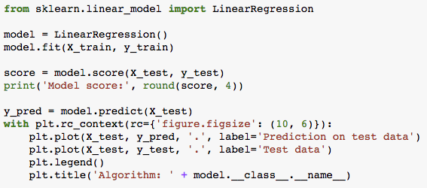
Real example: sklearn
Model score: 0.0066

Slide 29
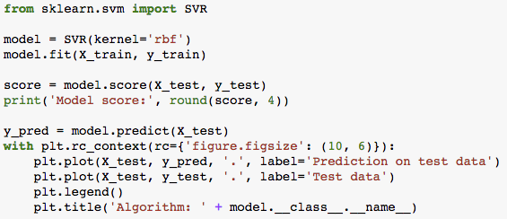
Real example: sklearn
Model score: 0.6144

Slide 30
One smell at the time: Context managers

Slide 31
The smell of context managers
Before executing the code, something needs to happen: open a file, connect to a DB, initialize some hardware
# Initialize context
try:
# The code you care about
finally:
# Clean up context
Once the code has executed, we need to clean up, even if an error occurred: close the file, commit / revert SQL transactions, disconnect from hardware
… becomes …
with my_context_manager():
# The code you care about

Slide 32
The classic example
file = open('MyFile.txt ', 'w')
try:
file.write('Writing this.') finally:
file.close()
with open('MyFile.txt', 'w') as outfile:
outfile.write('Writing this.')
try:
# The code you care about
except:
# When things go wrong
finally:
# Clean up context
with my_context_manager():
# The code you care about

Slide 33
Context managers can be implemented as classes or using decorators/generators
from contextlib import contextmanager
@contextmanager
def open_file(name):
f = (name, 'w')
yield f
f.close()
class File(object):
def __init__(self, file_name, method): self.file_obj = open(file_name, method)
def __enter__(self):
return self.file_obj
def __exit__(self, type, value, traceback): self.file_obj.close()
with open_file('MyFile.txt') as f:
f.write('Writing this.')
with File('MyFile.txt', 'w') as f:
f.write('Writing this.')

Slide 34
Go to “context managers” notebooks

Slide 35
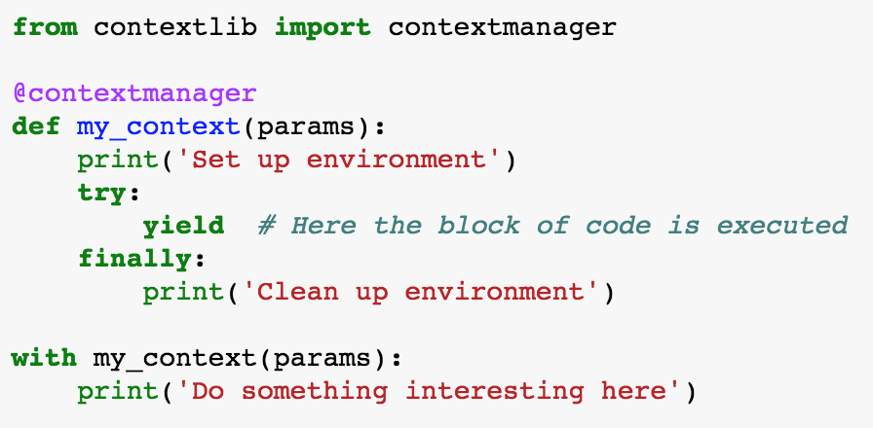
Recap: Context managers
Context managers eliminate the smell of repeatedly setting up and cleaning up an environment in which code needs to run

Slide 36
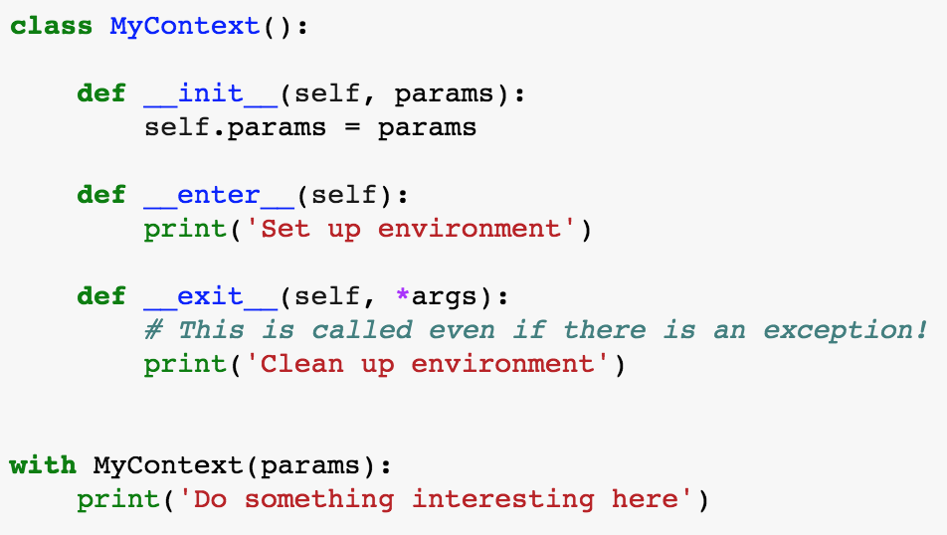
FYI: most general way of defining context manger
@contextmanager is a shortcut for writing a class with magic methods __enter__ and __exit__:

Slide 37
Keep your nose ready!
The smell of generators
The smell of context managers
for ... :
# Transform / filter
for ... :
# Transform / filter
# The interesting part of the code
# Prepare
try:
# The code you care about
finally:
# Clean up
The smell of classes
The smell of decorators
def first_function(x, y, z):
# Something
def second_function(x, y, z):
# Something else
def third_function(x, y, z):
# Something more
def my_function(x, y, z):
# Common boilerplate at beginning
# Function-specific part
# Common boilerplate at end

Slide 38
Decorators
Decorators are functions which modify the functionality of other functions
Everything in Python is an object
def hi(name):
return ″hi ″ + name
print(hi(″Jana″))
hi Jana
greet = hi #Assign a function to a variable!
print(greet(″Jana″))
hi Jana

Slide 39
Decorators
def decorator_func(func):
def wrapper_func():
print("Wrapper function started")
func()
print("Wrapper function ended")
return wrapper_func
hi = decorator_func(hi)
hi
<function __main__.decorator_func.<locals>.wrapper_func()>
#Same as saying hi = decorator_func(hi)
@decorator_func
def hi():
print("Hi")
hi()
Wrapper function started
Hi
Wrapper function ended
def hi():
return "Hi"
print(hi())
Hi
#Assign a function to a variable!
greet = hi
print(greet())
Hi

Slide 40
Decorators are useful for logging, analytics…
from myapp.log import logger
def log_order_event(func):
def wrapper(*args, **kwargs):
logger.info("Ordering: %s", func.__name__)
order = func(*args, **kwargs)
logger.debug("Order result: %s", order.result)
return order
return wrapper
@log_order_event
def order_pizza(*toppings):
# let's get some pizza!

Slide 41
Where to go from here…
realpython.com

Slide 42
Thank you!

